Slide 1
ME759 High Performance Computing for Applications in Engineering [Spring 2020]
Lecture 08
02/07/2019
Dan Negrut, 2020 ME759 UW-Madison

Slide 2
Quote of the day
“Wikipedia is the best thing ever. Anyone in the world can write anything they want about any subject. So you know you are getting the best possible information.”
-- Michael Scott, Regional Manager, Dunder Mifflin, Inc.

Slide 3
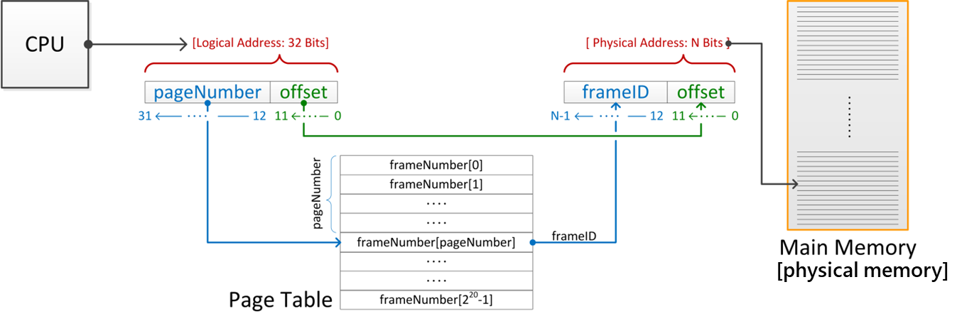
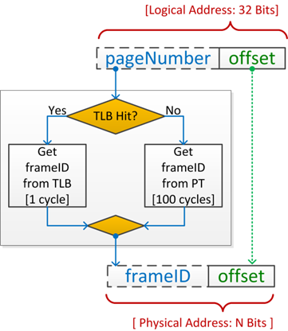
Before we get going…
Last time:
The Virtual Memory
A good thing, for many reasons
The Page Table
The TLB
Today
The 3 walls to sequential computing
Parallel computing, generalities
Other tidbits:
Assigned reading (syllabus gets updated)
Assignment due on Th at 9 pm
Use Piazza to get things going (for you or others)

Slide 4
Main causes for sequential computing speed stalling
Memory Wall
Instruction Level Parallelism (ILP) Wall
Power Wall
Not necessarily walls, but increasingly steep hills to climb
Source: “The Many-Core Inflection Point for Mass Market Computer Systems”, by John L. Manferdelli, Microsoft Corporation
http://www.ctwatch.org/quarterly/articles/2007/02/the-many-core-inflection-point-for-mass-market-computer-systems/
Notes:
Predicted in 2000:

Slide 5
Memory Wall
Memory Wall: What is it?
The growing disparity of speed between CPU and memory outside the chip
Memory accesses have gradually become a mighty barrier to computer performance improvements
The trend: ever growing caches to improve average memory reference time to fetch or write instructions or data
Caches are a transistor black hole
Also, as cache gets gradually larger, it also gets gradually slower
Memory Wall: due to latency and limited communication bandwidth beyond chip boundaries.

Slide 6
Memory Latencies [typical server and mobile computers]
Server
CPU
Registers
Mobile
Courtesy of Elsevier, Computer Architecture, Hennessey and Patterson, fifth edition
Notes:
Hammad: in the fifth edition of the book embedded/mobile have their own diagram

Slide 7
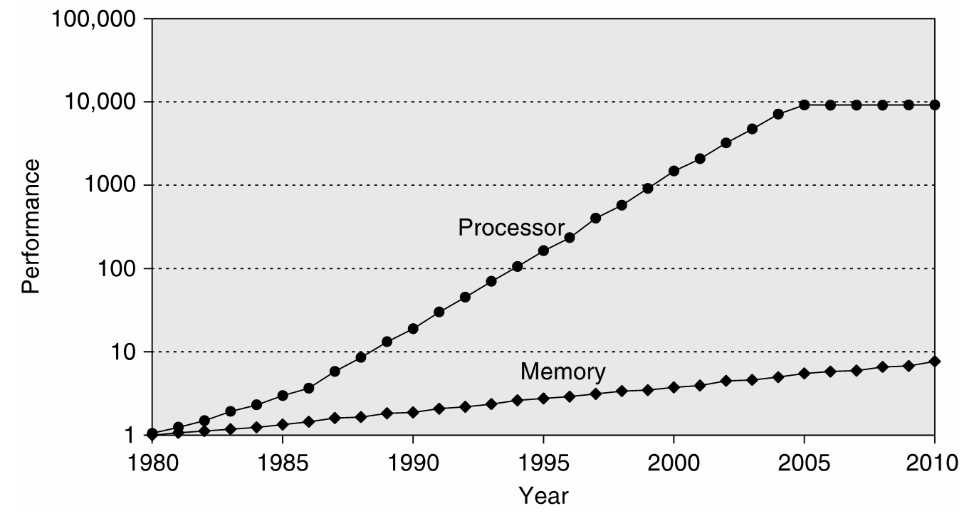
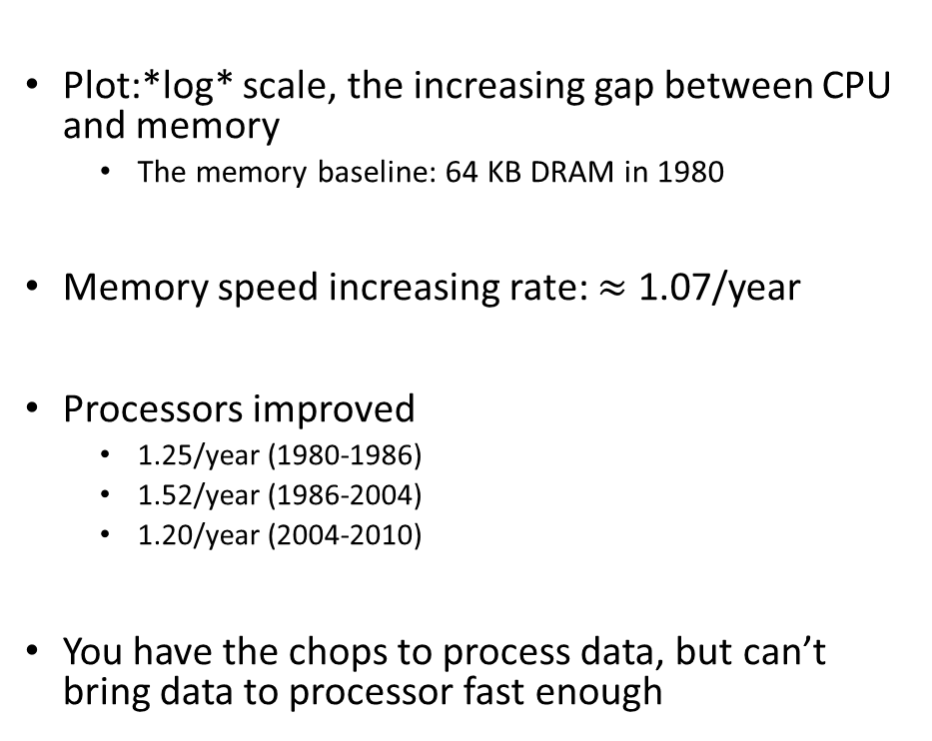
Memory Speed: Widening of the Processor-DRAM Performance Gap
Plot:*log* scale, the increasing gap between CPU and memory
The memory baseline: 64 KB DRAM in 1980
Memory speed increasing rate: $≈$ 1.07/year
Processors improved
1.25/year (1980-1986)
1.52/year (1986-2004)
1.20/year (2004-2010)
You have the chops to process data, but can’t bring data to processor fast enough

Slide 8
Memory Latency vs. Memory Bandwidth
Latency [in our context]: how much time it takes a packet of data to get from one designated point to another
Measured in seconds, also called “lag”
The utility “ping” in Linux measures the latency of a network
For memory transactions: send 32 bits to destination and back, measure how much time it takes gives you latency
Bandwidth: how much data can be transferred per second
You can talk about bandwidth for memory but also for a network (Ethernet, Infiniband, modem, DSL, etc.)
Improving Latency and Bandwidth
Mostly the job of folks in Electrical Engineering
Once in a while, Materials Science colleagues deliver a breakthrough
Promising technology: optic networks; layered memory on top of chip; etc.

Slide 9
Memory Latency vs. Memory Bandwidth
Memory Access Latency more challenging to improve as opposed to improving Memory Bandwidth
Improving Bandwidth: add more “pipes”
Requires more pins that come out of the chip for DRAM, for instance
Adding more pins is not simple – very crowded real estate plus the technology is tricky
Improving Latency: no easy answer here
Analogy:
If you carry commuters with a train, add more cars to a train to increase bandwidth
Improving latency requires the construction of high speed trains (expensive/complex)

Slide 10
Latency vs. Bandwidth: Recent Evolution of Speed Gains
Courtesy of Elsevier, Computer Architecture, Hennessey and Patterson, fifth edition
Notes:
For the Microprocessor this is measured in MIPS (million instructions per second). Many reported IPS values have represented "peak" execution rates on artificial instruction sequences with few branches, whereas realistic workloads typically lead to significantly lower IPS values.

Slide 11
Memory Wall, Conclusions [IMPORTANT SLIDE]
Take-home message: Long and winding conversations with main memory kills execution speed
Memory-wise, you may or may not be at top speed for your memory
Effective bandwidth==Nominal bandwidth: you move lots of data - ok, fact of life, some applications are just like that
Effective bandwidth < Nominal bandwidth: you bring a block of data, use little of it, and ask for data from a different block
Examples – sparse matrix operations, combinatorics, etc.

Slide 12
Memory Wall, Conclusions [IMPORTANT SLIDE]
This is an important picture to have in mind when writing software
Courtesy of Elsevier, Computer Architecture, Hennessey and Patterson, fifth edition

Slide 13
The next wall: Instruction Level Parallelism (ILP)
Instruction pipelining: the execution of multiple instructions overlapped; each instructions is divided into series of sub-steps (termed: micro-operations)
Superscalar execution: multiple execution units are used to execute multiple instructions in parallel
Out-of-order execution: instructions execute in any order but without violating data dependencies
Register renaming: a technique used to avoid data hazards and thus lead to unnecessary serialization of program instructions
Speculative execution: allows the execution of complete instructions or parts of instructions before being sure whether this execution is required
Branch prediction: used to avoid delays (termed: stalls). Used in combination with speculative execution.

Slide 14
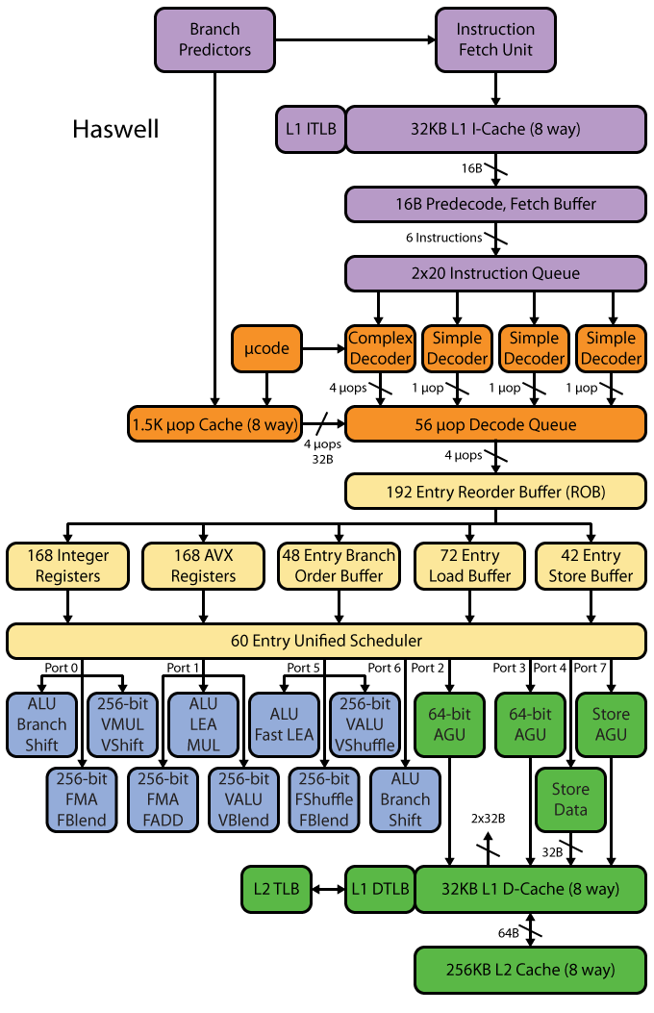
Intel Haswell example: ILP elicits very complex microarchitecture
[http://www.realworldtech.com/haswell-cpu/ ]→
Notes:
Dan - AGU: Address generation unit

Slide 15
Sample Pipeline Depths
Pipeline Depth | Processors
6 | UltraSPARC T1
7 | PowerPC G4e
8 | UltraSPARC T2/T3, Cortex-A9
10 | Athlon, Scorpion
11 | Krait
12 | Pentium Pro/II/III, Athlon 64/Phenom, Apple A6
13 | Denver
14 | UltraSPARC III/IV, Core 2, Apple A7/A8
14/19 | Core i*2/i*3 Sandy/Ivy Bridge, Core i*4/i*5 Haswell/Broadwell
15 | Cortex-A15/A57
16 | PowerPC G5, Core i*1 Nehalem
18 | Bulldozer/Piledriver, Steamroller
20 | Pentium 4
31 | Pentium 4E Prescott
[http://www.lighterra.com/papers/modernmicroprocessors/]→

Slide 16
The ILP Wall
Dedicated hardware speculatively executes future instructions before the results of current instructions are known, while providing hardware safeguards to prevent the errors that might be caused by out of order execution
Branches must be “guessed” to decide what instructions to execute simultaneously
If you guessed wrong, you throw away that part of the result
Data dependencies may prevent successive instructions from executing in parallel, even if there are no branches
Predicting the future comes at the cost of microarchitecture complexity and power cost

Slide 17
The ugly head of speculative execution
Speculative execution difficult to implement safely
Has become infamous for a recently-revealed series of bugs
Meltdown (Intel, IBM, some ARM)
Foreshadow (Intel)
Spectre (everything before 2019 that uses branch prediction)

Slide 18
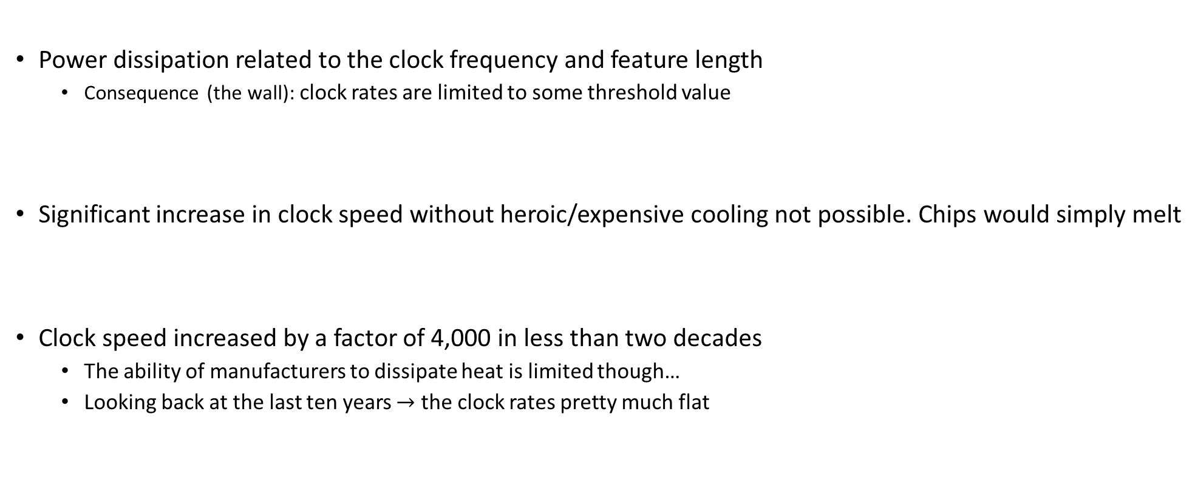
_{[The last wall]} The Power Wall
Power dissipation related to the clock frequency and feature length
Consequence (the wall): clock rates are limited to some threshold value
Significant increase in clock speed without heroic/expensive cooling not possible. Chips would simply melt
Clock speed increased by a factor of 4,000 in less than two decades
The ability of manufacturers to dissipate heat is limited though…
Looking back at the last ten years $→$ the clock rates pretty much flat

Slide 19
The Power Wall
Power, and not manufacturing, limits traditional general purpose microarchitecture improvements
Point made already in 1999 by F. Pollack, Intel Fellow, see here .
Kind of true, but sadly Intel not pushing the manufacturing frontier anymore
Leakage power dissipation gets worse as gates get smaller, because gate dielectric thicknesses decrease proportionately

Slide 20
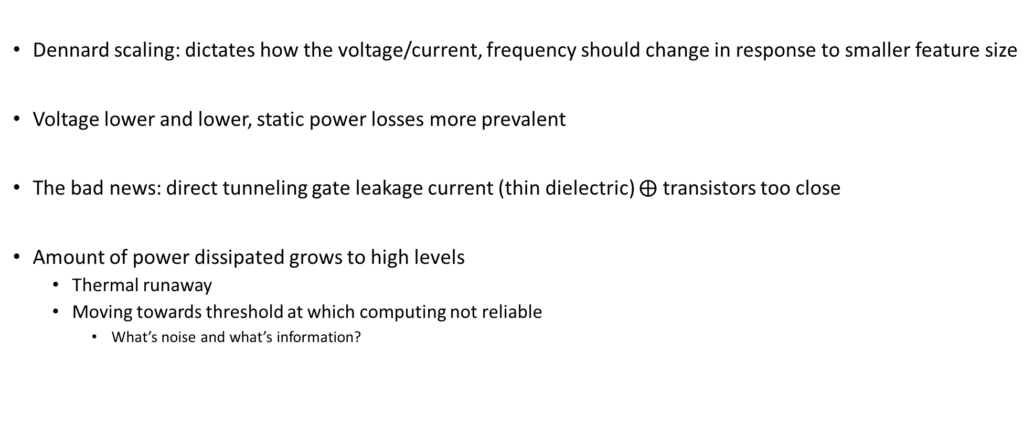
Dennard’s Scaling: Making Moore’s Law Useful
Dennard scaling: dictates how the voltage/current, frequency should change in response to smaller feature size
Voltage lower and lower, static power losses more prevalent
The bad news: direct tunneling gate leakage current (thin dielectric) $⨁$ transistors too close
Amount of power dissipated grows to high levels
Thermal runaway
Moving towards threshold at which computing not reliable
What’s noise and what’s information?

Slide 21
The “dark silicon”
Dark Silicon: transistors that manufacturers cannot afford to turn on
Too many transistors on a chip – cannot afford to power them lest the chip melts
Esmaeilzadeh, H.; Blem, E.; St.Amant, R.; Sankaralingam, K.; Burger, D., "Dark silicon and the end of multicore scaling," in Comp. Architecture (ISCA), 2011 38th Annual International Symp., pp.365-376, 2011

Slide 22
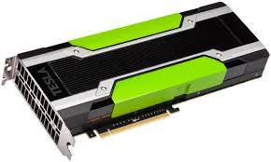
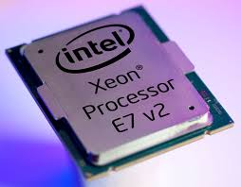
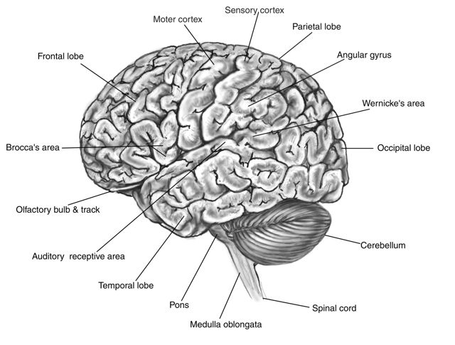
One slide detour: “spending energy” rates
NVIDIA Tesla K80
TDP: 300 Watts
Intel® Xeon® Processor E7-8890 v3
TDP: 165 Watts
Human Brain
20 Watts
Represents 2% of our mass
Burns 20% of all energy in the body at rest
Our entire body, ball park: 100-120 Watts
Notes:
[DN]
For a Opteron 6276, TDP is 115 W.
The Thermal Design Power (TDP) is the average maximum power a processor can dissipate while running commercially available software. TDP is primarily used as a guideline for manufacturers of thermal solutions (heatsinks/fans, etc) which tells them how much heat their solution should dissipate. TDP is not the maximum power the CPU may generate - there may be periods of time when the CPU dissipates more power than designed, in which case either the CPU temperature will rise closer to the maximum, or special CPU circuitry will activate and add idle cycles or reduce CPU frequency with the intent of reducing the amount of generated power.
TDP is usually 20% - 30% lower than the CPU maximum power dissipation.

Slide 23
Shift in Perception
Yesterday’s school of thought
Today’s take
Increasing clock frequency is primary method of performance improvement
Processors parallelism is primary method of performance improvement
Yesterday’s school of thought
Today’s take
Less than linear scaling for a multiprocessor is failure
Even sub-linear speedups are beneficial as long as you beat the sequential on a watt-to-watt basis

Slide 24
Conventional Wisdom in Computer Architecture
Power Wall
Old: Transistors expensive; Power is free
New: Transistors free; Power management very tricky (consequences, “lots of power”: heat to be dissipated & battery management)
Old: Math is slow; Memory access is fast
New: Math is fast; Memory slow (200 cycles for DRAM memory access, 1 cycle for pipelined FMA)
Old: Increasing Instruction Level Parallelism hardware and compilers (Out-of-order, speculation, VLIW, …)
New: ILP sees diminishing returns; non-ILP parallelism pursued
Memory Wall
ILP Wall
Notes:
Power wall + Memory wall + ILP wall → BRICK wall

Slide 25
Just a bunch of bad news…
OK, now what?

Slide 26
The bright spot
We can produce small[er] transistors and we are increasingly good at packaging them in ICs

Slide 27
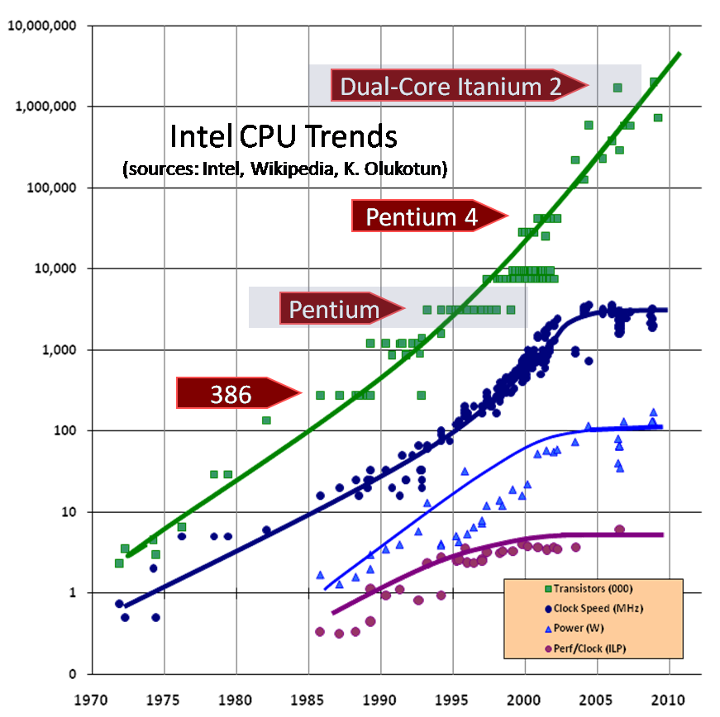
Good news: number of transistors going up

Slide 28
Moore’s Law (1965)
“The complexity for minimum component costs has increased at a rate of roughly a factor of two per year [see graph on next page]. Certainly over the short term this rate can be expected to continue, if not to increase. Over the longer term, the rate of increase is a bit more uncertain, although there is no reason to believe it will not remain nearly constant for at least 10 years. That means by 1975, the number of components per integrated circuit for minimum cost will be 65,000. I believe that such a large circuit can be built on a single wafer.”
“Cramming more components onto integrated circuits” by Gordon E. Moore, Electronics, Volume 38, Number 8, April 19, 1965

Slide 29
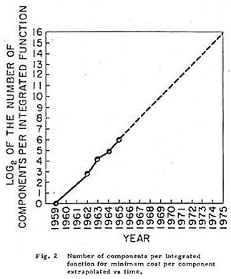
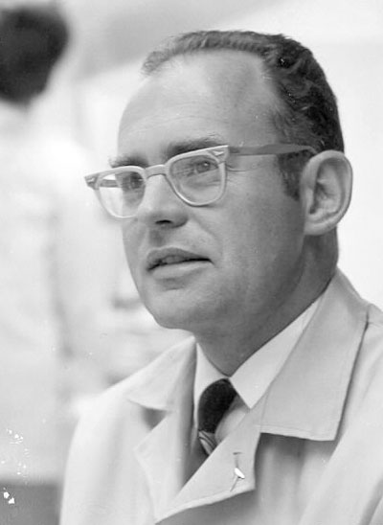

Moore’s Law
1965 paper: Doubling of the number of transistors on integrated circuits every two years
Moore himself wrote only about the density of components (or transistors) at minimum cost
http://news.cnet.com/Images-Moores-Law-turns-40/2009-1041_3-5649019.html

Slide 30
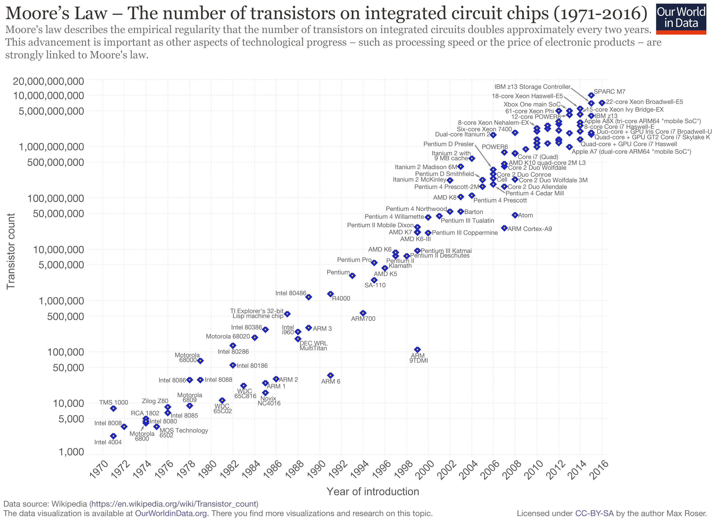

Slide 31
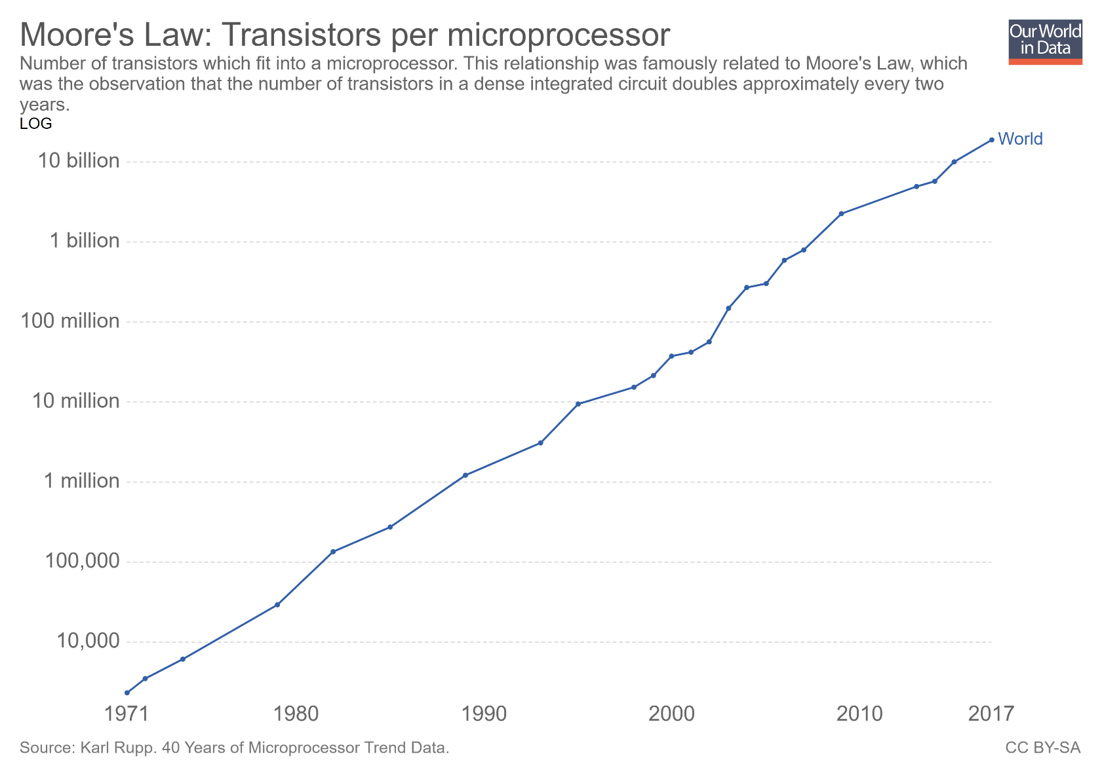
Moving to the processor: transistor counts per microprocessor

Slide 32
Intel Roadmap [or other folks’ roadmap]
2013 – 22 nm Tick: Ivy Bridge – Tock: Haswell
2015 – 14 nm Tick: Broadwell – Tock: Skylake
2016 – 14nm “Refresh” Kaby Lake
2017 – 10 nm Cannon Lake (delayed to 2019)
2019 – 7 nm [AMD: Radeon Instinct MI60/Zen2]
2021 – 5 nm (Samsung & TSMC, in testing)
2023 – 3 nm (Samsung?)
Notes:
Hammad: Even intel is having problems going down in process technologies. 10nm was delayed until the second half of 2017. Broadwell didn’t have good yields, they never released a desktop version (only laptop) and went straight to skylake for desktop CPUs

Slide 33
Transistors bonanza: bringing happiness in lots of corners
Ability to cram more transistors per unit area and still make a profit good in many respects
Microprocessors
Memory capacity & speed
Storage controllers

Slide 34
Parallel computing: The Ox vs. Chickens Analogy
“If you were plowing a field, which would you rather use: Two strong oxen or 1024 chickens?” [Seymour Cray$→$]
Ox: one powerful CPU core, running at high frequency, lots of cache to hide memory latency
Chicken: many meagre processors, running at lower frequency, not much cache or brain (like in CU)
Requires other ways to hide memory latency
Few were eating chicken a decade ago but popular now

Slide 35
Two examples of Parallel HW: Putting to good use billions of transistors
Intel Haswell
Multicore architecture
Four oxen, that is
NVIDIA Fermi
Large number of scalar processors (“shaders”)
512 chicken, that is

Slide 36
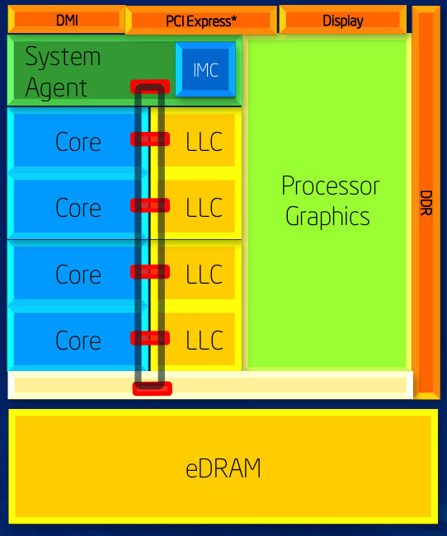
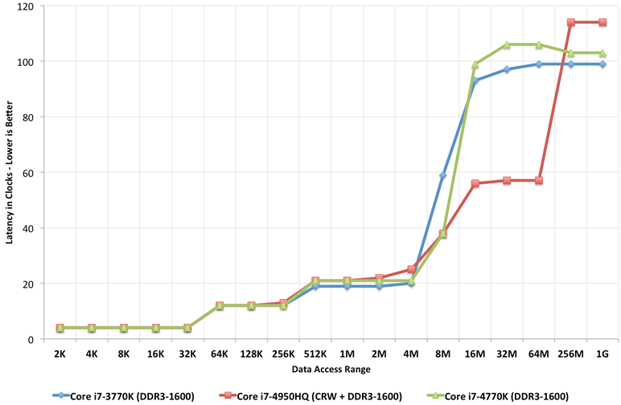
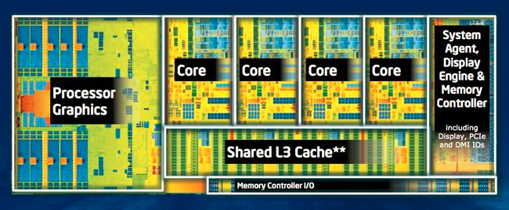
Intel Haswell
June 2013
22 nm technology
1.4 billion transistors
4 cores, HTT
Integrated GPU
System-on-a-chip (SoC) design
Notes:
Direct Media Interface (DMI) is the link between the northbridge and southbridge on a computer motherboard

Slide 37
Haswell example: multi-core architecture (four oxen)
Shared-Memory Multiprocessor Architecture
SRAM
SRAM
DRAM
Courtesy of Elsevier, Computer Architecture, Hennessey and Patterson, fifth edition
Notes:
Hammad – Updated Figure from fifth edition

Slide 38
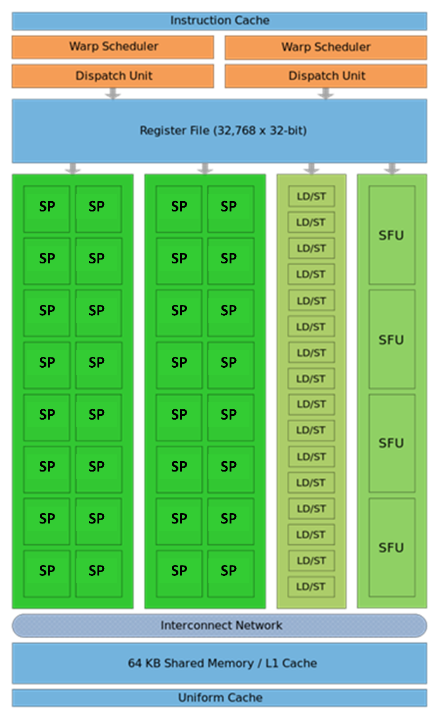
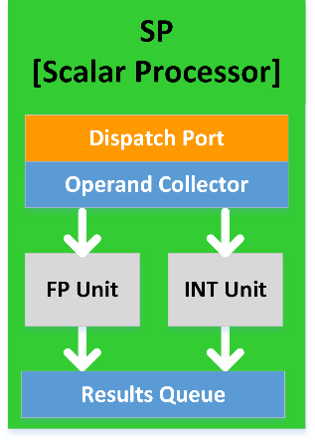
The Fermi Architecture [ Schematic of a NVIDIA Stream Multiprocessor (SM)]
Late 2009, early 2010
40 nm technology
Three billion transistors
512 Scalar Processors (SPs), or “shaders”
This is the chicken
L1 cache
L2 cache
6 GB of global memory
Operates at low clock rate
High bandwidth (close to 200 GB/s)

Slide 39
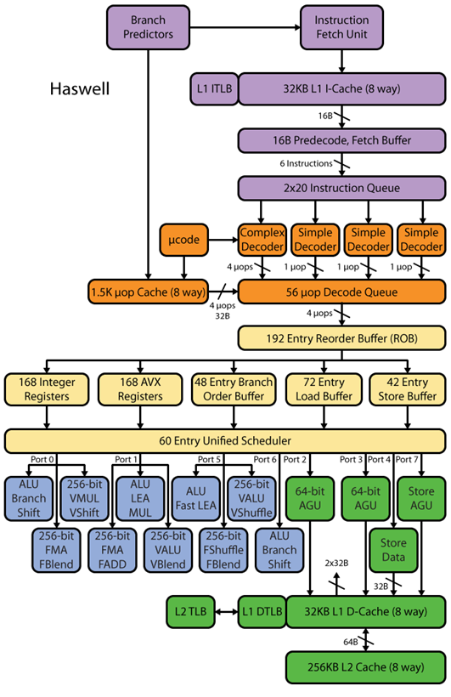
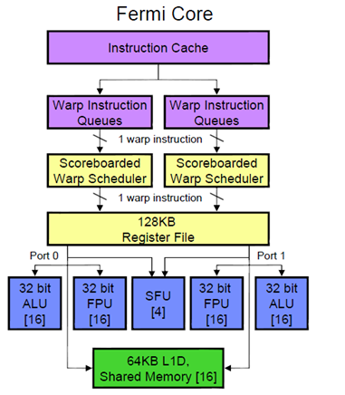
A Fermi SM (Streaming Multiprocessor; one of 16)
Not a whole lot of brain here, yet a lot of power

Slide 40
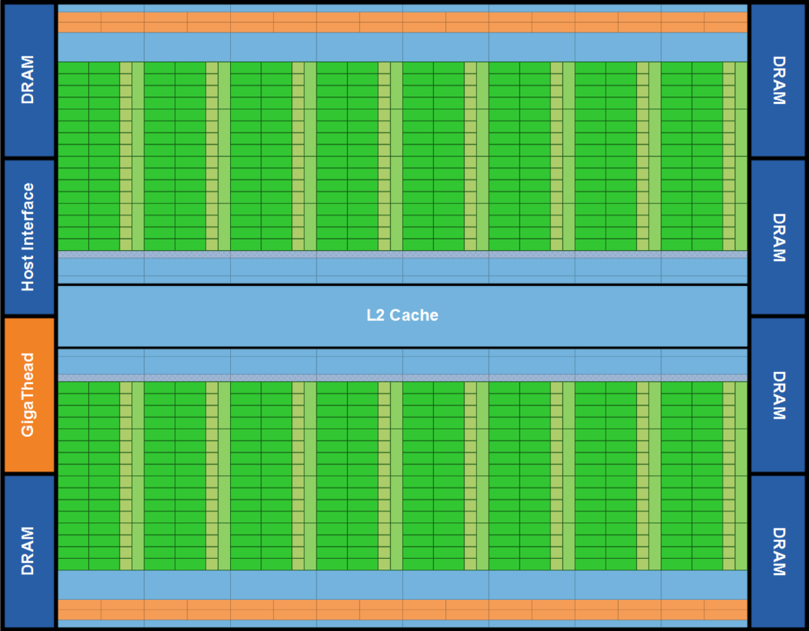
Fermi: 30,000 feet perspective, the entire chip
Lots of ALU (green), not much of CU (orange)
Explains why GPUs are fast for high arithmetic intensity applications
Arithmetic intensity: high when many operations performed per byte of data

Slide 41
The CPU and GPU: their true colors
The GPU is specialized for compute-intensive, highly data parallel computation (owing to its graphics rendering origin)
More transistors devoted to data processing rather than data caching and control flow
Where are GPUs good: high arithmetic intensity (the ratio between arithmetic operations and memory operations)
The video game industry exerts strong economic pressure that pushes things forward in GPU computing
Control
ALU
ALU
ALU
ALU
CPU
GPU
Cache
DRAM
DRAM

Slide 42
Beefy CPU vs. beefy GPU comparison, 2019
 | GPU – NVIDIA Tesla V100 32GB $8,995 | CPU – Intel® Xeon® Platinum 8180 $10,009
Processing Cores | 5120 CUDA Cores 640 Tensor Cores | 28 cores (56 threads, SMT)
Memory | 32GB HBM2 | - 64 KB L1 (I+D) cache / core - 1 MB L2 cache / core - 38.5 MB L3 cache (1.375 MB / core), average
Clock speed | 1.29 GHz | 2.5 GHz (3.80 GHz Turbo; Throttles to 2.3 GHz when all FP units are active)
Memory bandwidth | 900 GB/s | 119.21 GB/s (19.87 GB / channel / s)
Floating Point Throughput | 7.8 Double Precision TFLOP/s 15.6 Single Precision TFLOP/s | 2.0608 Double Precision TFLOP/s
TDP | 300 Watts | 205 Watts
https://en.wikipedia.org/wiki/Nvidia_Tesla
https://www.techpowerup.com/gpu-specs/tesla-v100-sxm2-32-gb.c3185
https://en.wikichip.org/wiki/intel/xeon_platinum/8180
https://ark.intel.com/products/120496/Intel-Xeon-Platinum-8180-Processor-38-5M-Cache-2-50-GHz-

Slide 43


3D Stacked Memory
Traditional GPU chip$⇔$ GDDR5 memory layout
New GPU (Pascal/Volta) chip$⇔$ HBM2 memory layout
Major step forward in performance.

Slide 44
3D Stacked Memory
SK Hynix’s High Bandwidth Memory (HBM)
Developed by AMD and SK Hynix
1st Generation (HBM1) introduced in AMD Fiji GPUs
1GB & 128GB/s per stack
AMD Radeon R9 Fury X: had four stacks → 4GB & 512GB/s
2nd Generation (HBM2) used in NVIDIA Pascal/Volta and AMD Arctic Island GPUs
2 GB & 256GB/s bandwidth per stack
NVIDIA Volta approximately 900 GB/s memory bandwidth
Apparently AMD has 1024 GB/s HBM available
Notes:
PHY: die-to-die [physical?] interconnect (see https://www.synopsys.com/dw/ipdir.php?ds=dwc_die-to-die_phy)

Slide 45
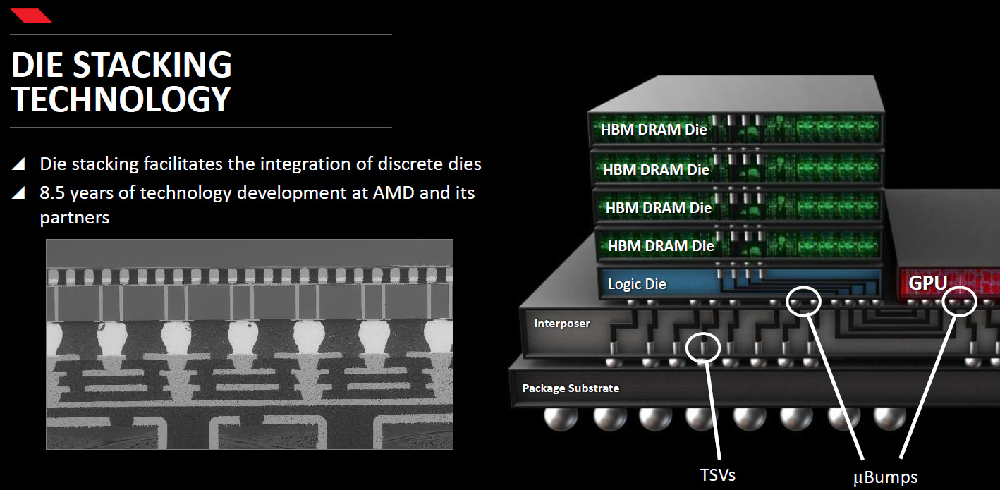
3D Stacked Memory

Slide 46
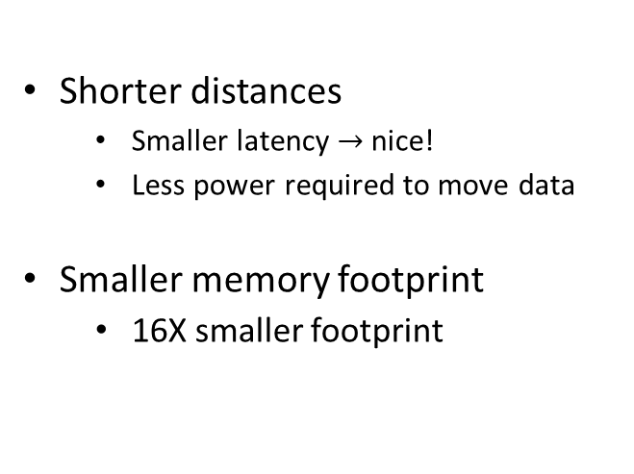
3D Stacked Memory
One HBM stack, made up of four DRAM dies (4-Hi)
Shorter distances
Smaller latency $→$ nice!
Less power required to move data
Smaller memory footprint
16X smaller footprint
Logic die

Slide 47
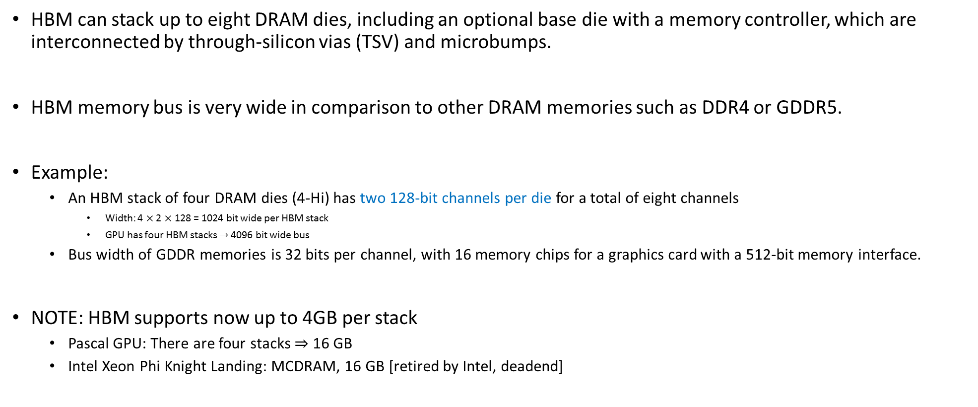
Other Tidbits, HBM
HBM can stack up to eight DRAM dies, including an optional base die with a memory controller, which are interconnected by through-silicon vias (TSV) and microbumps.
HBM memory bus is very wide in comparison to other DRAM memories such as DDR4 or GDDR5.
Example:
An HBM stack of four DRAM dies (4-Hi) has two 128-bit channels per die for a total of eight channels
Width: 4 $×$ 2 $×$ 128 = 1024 bit wide per HBM stack
GPU has four HBM stacks $→$ 4096 bit wide bus
Bus width of GDDR memories is 32 bits per channel, with 16 memory chips for a graphics card with a 512-bit memory interface.
NOTE: HBM supports now up to 4GB per stack
Pascal GPU: There are four stacks $⇒$ 16 GB
Intel Xeon Phi Knight Landing: MCDRAM, 16 GB [retired by Intel, deadend]
Notes:
[Colin] NVIDIA has been moving to GDDR6 due to performance-limiting heat dissipation problems with stacked memory
[Colin] Cost of HBM manufacturing very high

Slide 48
[side trip, 1/2] on-chip vs. on-package vs. off-package
Where a resource is dictates to a large extent its communication latency and/or bandwidth
Example, on-chip: Intel Haswell has the GPU on the same chip with the rest of the CPU
Example, on-package: the 128 MB of eDRAM available on Intel Core i7 4950HQ
The GPU is on-chip
The eDRAM is on-package

Slide 49

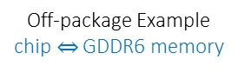
[side trip, 2/2] on-chip vs. on-package vs. off-package
Example, off-package vs. on-package: traditional memory vs. HBM
Off-package Example chip$⇔$ GDDR6 memory
On-package Example chip$⇔$ HBM2 memory

Slide 50
[New Topic] Flynn’s Taxonomy of Architectures
There are several ways to classify architectures
Below, classification based on how instructions are executed in relation to data
SISD - Single Instruction/Single Data
SIMD - Single Instruction/Multiple Data
MISD - Multiple Instruction/Single Data
MIMD - Multiple Instruction/Multiple Data

Slide 51
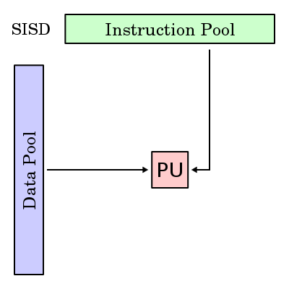

Single Instruction/Single Data (SISD) Architectures
PU – Processing Unit
Your desktop, before the spread of dual core CPUs
[Wikipedia, Flynn’s Taxonomy]$→$
Notes:
PU – Processing Unit

Slide 52

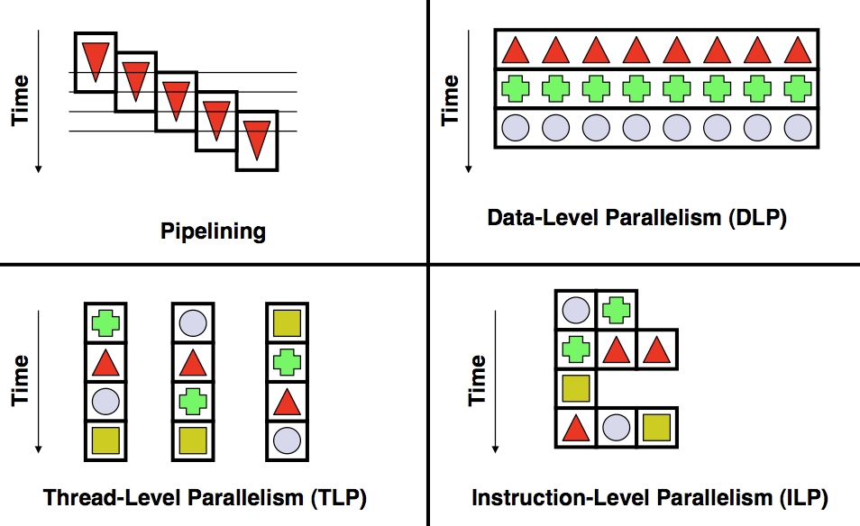
Increasing Throughput of SISD
Instructions:
Time
Time
Pipelining
Multiple Issue
[Wikipedia, Flynn’s Taxonomy]$→$

Slide 53
Single Instruction/Multiple Data (SIMD) Architectures
Processors that execute same instruction on multiple pieces of data: GPUs
[Wikipedia, Flynn’s Taxonomy]$→$
Notes:
Mention also AVX

Slide 54
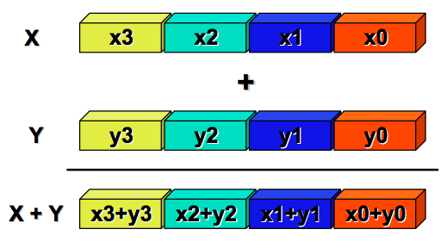

Single Instruction/Multiple Data (SIMD)
Each core runs the same set of instructions on different data
Examples:
Graphics Processing Unit (GPU): processes pixels of an image in parallel
CRAY’s vector processor
[Klimovitski & Macri, Intel]$→$
Notes:
Big data is a major motivator for this type of processing.
Whenever you see lots of data, first consider SIMD

Slide 55

SISD versus SIMD
Writing a compiler for SIMD architectures is difficult
(inter-thread communication complicates the picture…)
[Jon Stokes]$→$

Slide 56
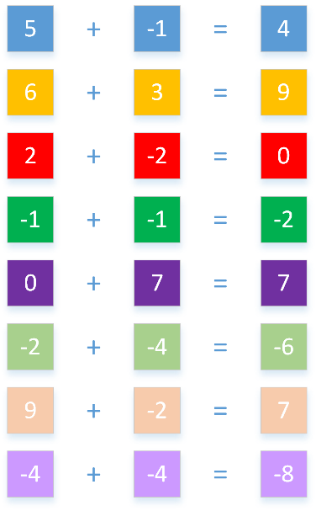
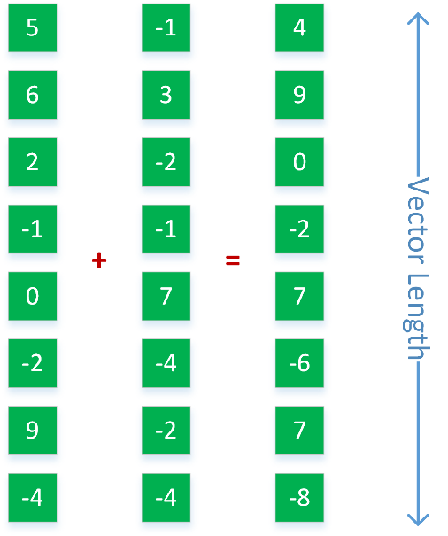
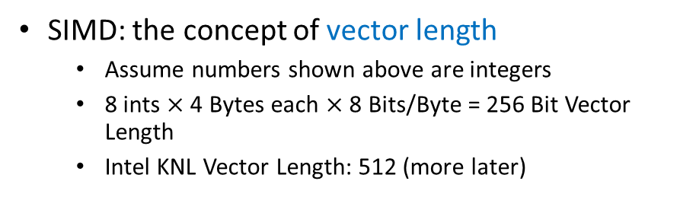
SISD, SIMD, and Vector Length
Accomplishing the same thing
A stream of 8 “SISD” instructions
One SIMD instruction
SIMD: the concept of vector length
Assume numbers shown above are integers
8 ints $×$ 4 Bytes each $×$ 8 Bits/Byte = 256 Bit Vector Length
Intel KNL Vector Length: 512 (more later)

Slide 57
Multiple Instruction/Single Data
Not useful, not aware of any commercial implementation…
[Wikipedia, Flynn’s Taxonomy]$→$

Slide 58
Multiple Instruction/Multiple Data
Almost all our desktop/laptop chips are MIMD systems
[Wikipedia, Flynn’s Taxonomy]$→$
Notes:
Most (all?) Top500 supercomputers based on MIMD

Slide 59
Multiple Instruction/Multiple Data
The sky is the limit: each PU is free to do as it pleases
Can be of either shared memory or distributed memory categories
Instructions:
Notes:
Before we move on, a couple of words on difference between HPC and HTC

Slide 60
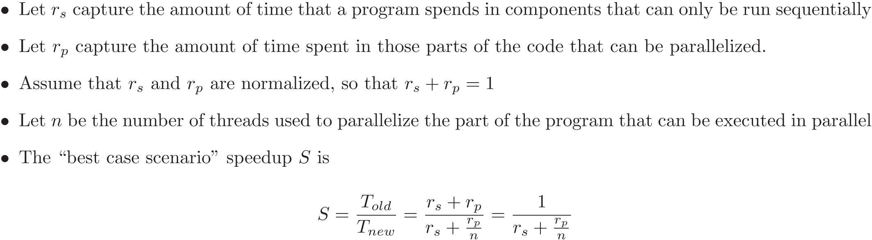
[New Topic] Amdahl's Law
“A fairly obvious conclusion which can be drawn at this point is that the effort expended on achieving high parallel processing rates is wasted unless it is accompanied by achievements in sequential processing rates of very nearly the same magnitude”
“Validity of the single processor approach to achieving large scale computing capabilities,” by Gene M. Amdahl, in Proceedings of the “AFIPS Spring Joint Computer Conference,” pp. 483, 1967
Notes:
How do you know if it makes sense or not to parallelize a piece of code?
What should you expect (in terms of speedup)?

Slide 61
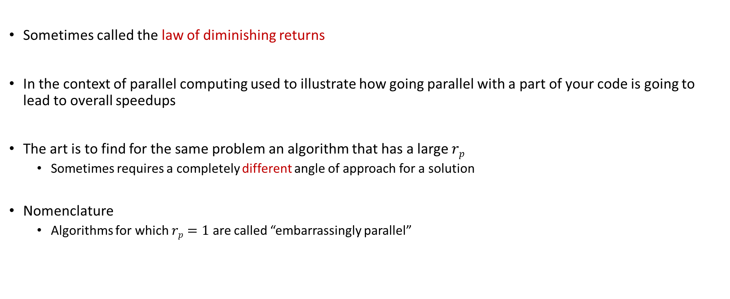
Amdahl’s Law
Sometimes called the law of diminishing returns
In the context of parallel computing used to illustrate how going parallel with a part of your code is going to lead to overall speedups
The art is to find for the same problem an algorithm that has a large $rp$
Sometimes requires a completely different angle of approach for a solution
Nomenclature
Algorithms for which $rp=1$ are called “embarrassingly parallel”

Slide 62
Example: Amdahl's Law
Suppose that a program spends 60% of its time in I/O operations, pre and post-processing
The rest of 40% is spent on computation, most of which can be parallelized
Assume that you buy a multicore chip and can throw 6 parallel threads at this problem.
What is the maximum amount of speedup that you can expect given this investment?
Asymptotically, what is the maximum speedup that you can ever hope for?
Notes:
Answer: 1.5X
(60 + 40)/(60 + 40/6)
Asymptotically: 100/60 = 5/3=1.666 X

Slide 63
Trivia
Gene Amdahl (1922-2015)
Graduated from UW-Madison (1952)
PhD, Mathematics and Physics
Amdahl’s law (1967)

Slide 64
GPU Computing with CUDA

Slide 65
The long view
Goal: Understand how GPUs can be used in Scientific Computing
Topics
Hardware considerations
“Hello World” with GPU computing
Execution configuration issues
The memory model in CUDA
Scheduling issues in CUDA
Occupancy and optimization issues
Notes:
It’s fast for a variety of jobs Really good for data parallelism (another way of saying SIMD)
It’s cheap to get one ($120 to $480) High end GPUs for Scientific Computing are more like $7000
GPUs are everywhere Chances are you have one or at least have easy access to one

Slide 66
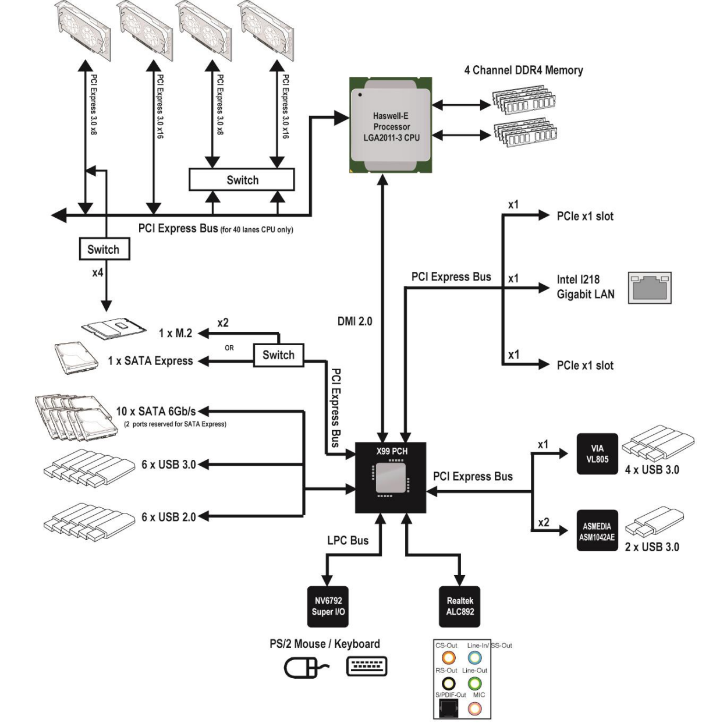
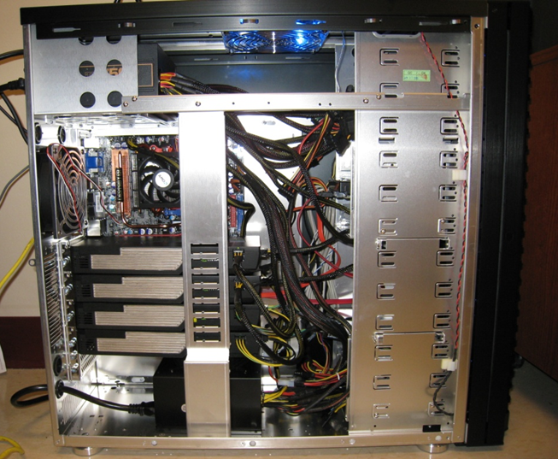

Typical Hardware Architecture
GPU w/ local DRAM
(the “device”)
CPU
(the “host”)
[http://www.anandtech.com]$→$
Notes:
thbridge now absorbed in CPU (the chipset).
GPUs also called accelerators or co-processors (complement the CPU).
The GPU connected through the PCIe bus
In PCIe 1.1 (currently the most common version) each lane sends information at a rate of 250 MB/s (250 million bytes per second) in each direction. PCIe 2.0 doubles this data rate, introduced in late 2007, PCIe 2.0 is found on newer systems such as those based around the Intel X38 or AMD 780G chipsets. The latest proposed PCIe 3.0 standard will increase the speed of the links further (tentatively scheduled for release around 2010).[1]
Each PCIe slot carries either one, two, four, eight, sixteen or thirty-two lanes of data between the motherboard and the addin card. Lane counts are written with an "x" prefix e.g. x1 for a single-lane card and x16 for a sixteen-lane card. Thirty-two lanes of 250 MB/s (PCIe 1.1) gives a maximum transfer rate of 8 GB/s (250 MB/s x 32, i.e., 8 billion bytes per second) in each direction. However the largest size in common use for PCIe 1.1 is x16, giving a transfer rate of 4 GB/s (250 MB/s x 16) in each direction. Putting this into perspective, a single lane for PCIe 1.1 has nearly twice the data rate of normal PCI, a four-lane slot has a transfer rate comparable to the fastest version of the old parallel PCI-X 1.0, and an eight-lane slot has a transfer rate comparable to the fastest version of AGP. However the data rates cited must be derated because 8b/10b coding is used in the physical layer. The link transfer speeds cited are to be considered maximum theoretical data rates.
PCIe slots come in a variety of physically different sizes referred to by the maximum lane count they support, ie. x1, x2, x4, x8, x16 and x32. A PCIe card will fit into a slot of its size or bigger, but not into a smaller PCIe slot.

Slide 67
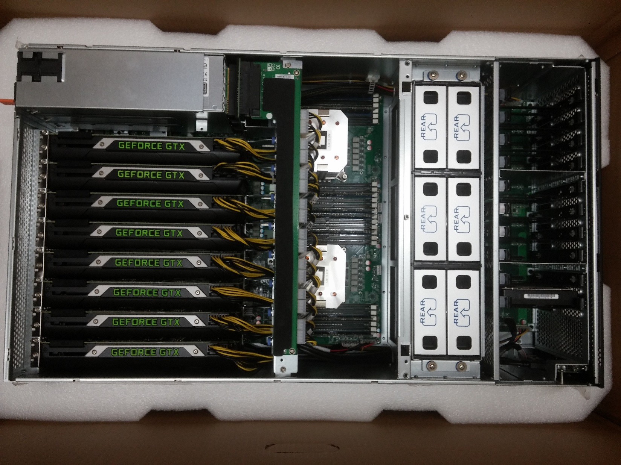
Euler Node, 2015 Vintage

Slide 68
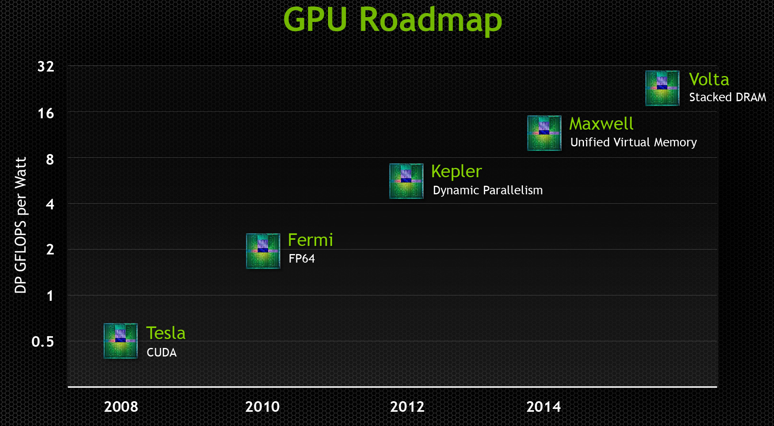
NVIDIA GPU Roadmap
Latest architecture for scientific computing: Volta
Notes:
Next (2018): Volta

Slide 69
GPU computing: eager to accommodate Machine Learning needs

Slide 70
Fermi: High-level Perspective
Lots of ALU (green), not much of CU (orange)
Explains why GPUs are fast for high arithmetic intensity applications
Arithmetic intensity: high when many operations performed per word of memory access
Notes:
How else could you organize 3 billion (today 7 billion) transistors?
Specialize the hardware. Organize it into a bunch of Streaming Multiprocessors and dedicate most transistors to number crunching (ALUs)

Slide 71
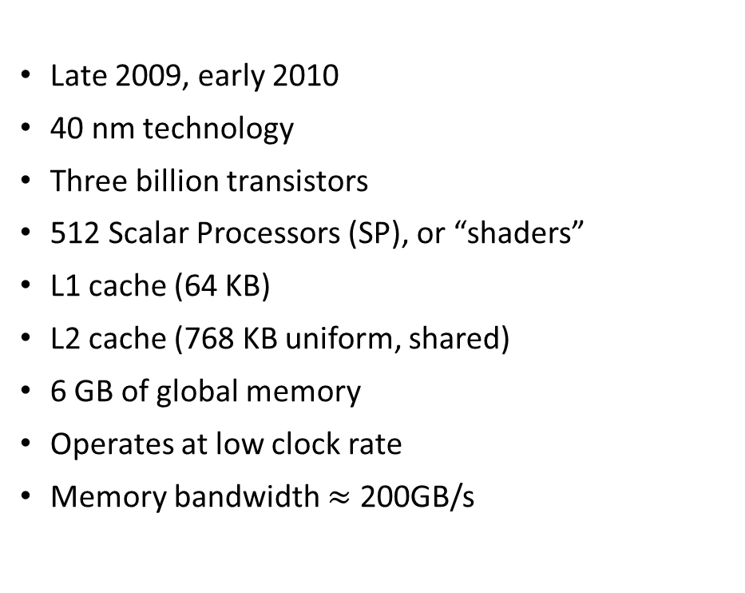
The Fermi Architecture
Late 2009, early 2010
40 nm technology
Three billion transistors
512 Scalar Processors (SP), or “shaders”
L1 cache (64 KB)
L2 cache (768 KB uniform, shared)
6 GB of global memory
Operates at low clock rate
Memory bandwidth $≈$ 200GB/s
Notes:
An SM is the quantum of scalability on a GPU. More $ → more SMs
Think of an SM as a single core on a CPU (do not buy into NVIDIA’s marketing)
Why is this important? Think of launching a job with 1 million threads. The more SMs you have, the more SPs…
512= 16 x 32
Components:
16+16 = 32 SPs
16 load/store units
4 SFU (for special functions)
2 warp schedulers
Several clock rates:
Shaders (SPs)
Scheduler: ½ the frequency of the SPs
Memory: own rate

Slide 72
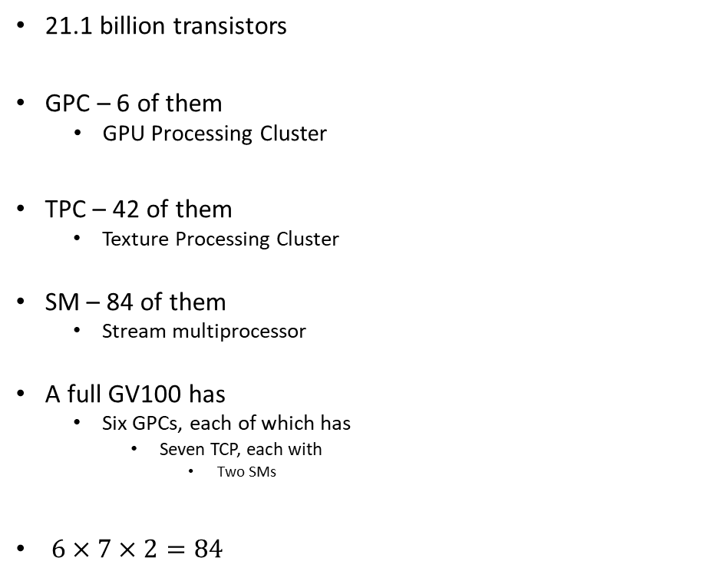
NVIDIA Volta GV100: microarchitecture schematic and nomenclature
21.1 billion transistors
GPC – 6 of them
GPU Processing Cluster
TPC – 42 of them
Texture Processing Cluster
SM – 84 of them
Stream multiprocessor
A full GV100 has
Six GPCs, each of which has
Seven TCP, each with
Two SMs
$6×7×2=84$
Notes:
A full GV100 GPU has a total of:
5376 FP32 cores
5376 INT32 cores
2688 FP64 cores
672 Tensor Cores
336 texture units

Slide 73

NVIDIA Volta GV100: microarchitecture schematic and nomenclature
Each SM has
64 FP32 scalar processors (SPs)
64 INT32 scalar processors (SPs)
32 FP64 scalar processors (SPs)
8 Tensor scalar processors (SPs)
Four texture units
It’s own L0 Instruction Cache
A wrap scheduler
A Dispatch unit
16,384 registers
[NVIDIA]$→$

Slide 74

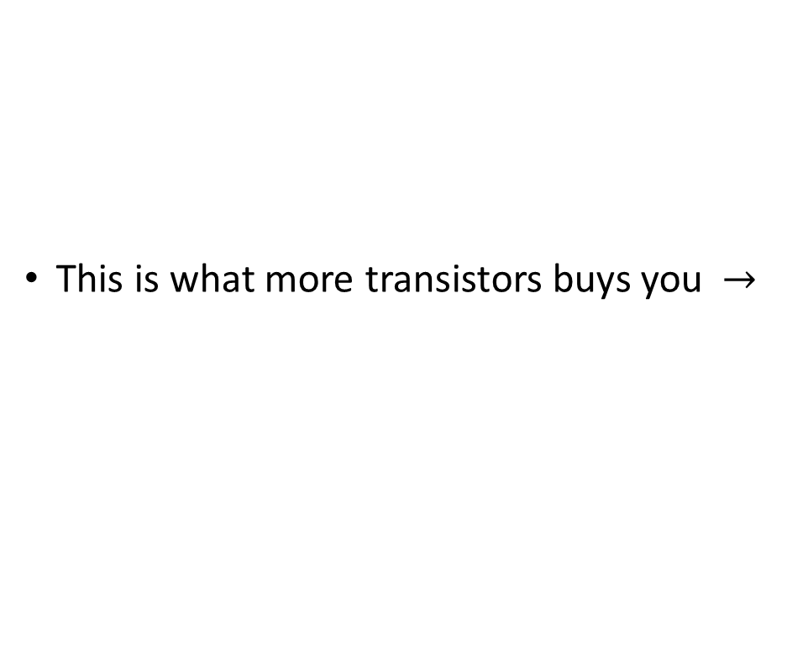
Performance overview, last four NVIDIA GPU generations
This is what more transistors buys you $→$
[NVIDIA]$→$

Slide 75
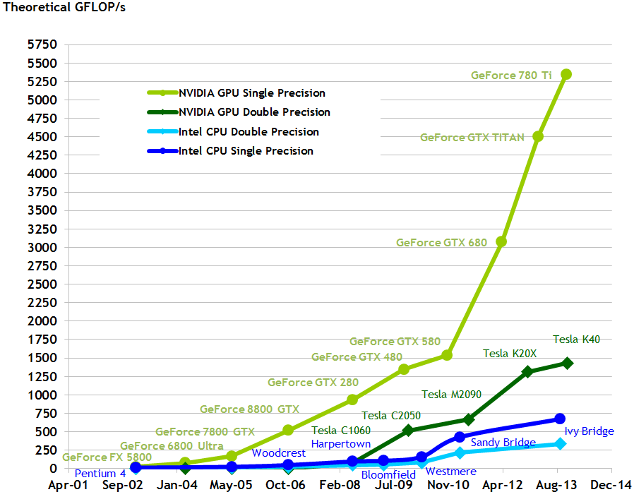
Pascal (P100) doubled the single precision performance: 10.6 TFLOPS
Notes:
Xeon E7-8800 v4: 0.844 TFLOPS

Slide 76
High Speed Requires High Bandwidth
Assume that you want to add two arrays and reach 1 Tflops: 1E12 ops/second
You need to fetch/feed 2E12 operands per second…
Assume each number is stored using 4 bytes (float or integer)
You need to fetch 2E12*4 bytes in a second. This is 8E12 B/s, which is 8 TB/s…
You haven’t taken into account that you probably want to send back the outcome of the operation that you carry out
The global memory bandwidth on the GPU is in the neighborhood of 1 TB/s (1000 GB/s)
About 8 times less than what you need
Conclusion: you need data in cache, global memory can’t sustain 1 Tflops
Notes:
The solution is to keep data in registers (more about this later)
The bandwidth of accessing data from registers is exactly around 8 TB/s.
Here’s a set of rules that you need to keep in mind before going further…
Get the data on the GPU and keep it there
Give the GPU enough work to do (High arithmetic intensity)
Focus on data reuse within the GPU to avoid memory bandwidth limitations

Slide 77
Bandwidth in a CPU-GPU System
Latency:
Low
GPU SMs
CPU Core
Cache L1: 32 KB
L2: 256 KB
L3: 45 MB (shared)
80GB/s
NOTE: The width of the black lines is proportional to the bandwidth.
50-100
GB/s
900
GB/s
Latency:
Medium Low
Latency:
Rel.Low
System Memory
(256 GB)
GPU Memory
(32 GB)
Infiniband to Next Node
8-16 GB/s
6GB/s
Latency:
High
Latency:
Medium
77
Notes:
77
Hammad – GPU numbers are for a Pascal P100, PCI numbers are for PCIe3
Infiniband is assuming mellanox results from here: http://www.mellanox.com/page/performance_infiniband
CPU memory numbers are for a E7 8890v3 http://ark.intel.com/products/84685/Intel-Xeon-Processor-E7-8890-v3-45M-Cache-2_50-GHz
CPU cache numbers are an average between expected L1 and L3 cache performance (not exact but approximate)

Slide 78
Info on Previous Slide
GPU numbers are for an NVIDIA Pascal V100
PCI numbers are for PCIe3
Infiniband is assuming Mellanox results from here
CPU memory numbers are for a E7 8890v3, 2.5GHz, 45MB L3
CPU cache numbers: an average between expected L1 and L3 speed
Not exact, but approximate

Slide 79
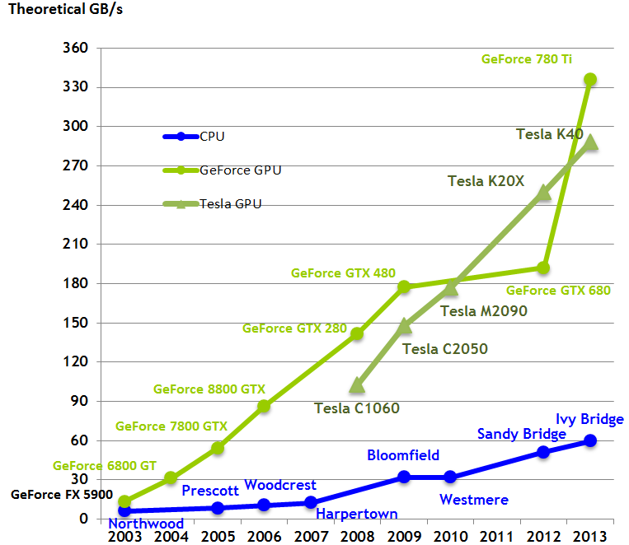
Notes:
If you look at flop rates GPU/CPU, also about 5 (roughly like the bandwidth ratio)
Take away message: you can expect a speedup of 2-10 if moving to GPU. Do not expect 100x
Tesla P100 (Pascal): 720 GB/s (stacked memory) → short detour

